Slide 1

JS @ Clutch
1
2
3
Stack
The pieces and how they go together
JavaScript
Concepts to know and understand
Package Specific Notes
Packages we use and how to use them

Slide 2
The
Stack

Slide 3
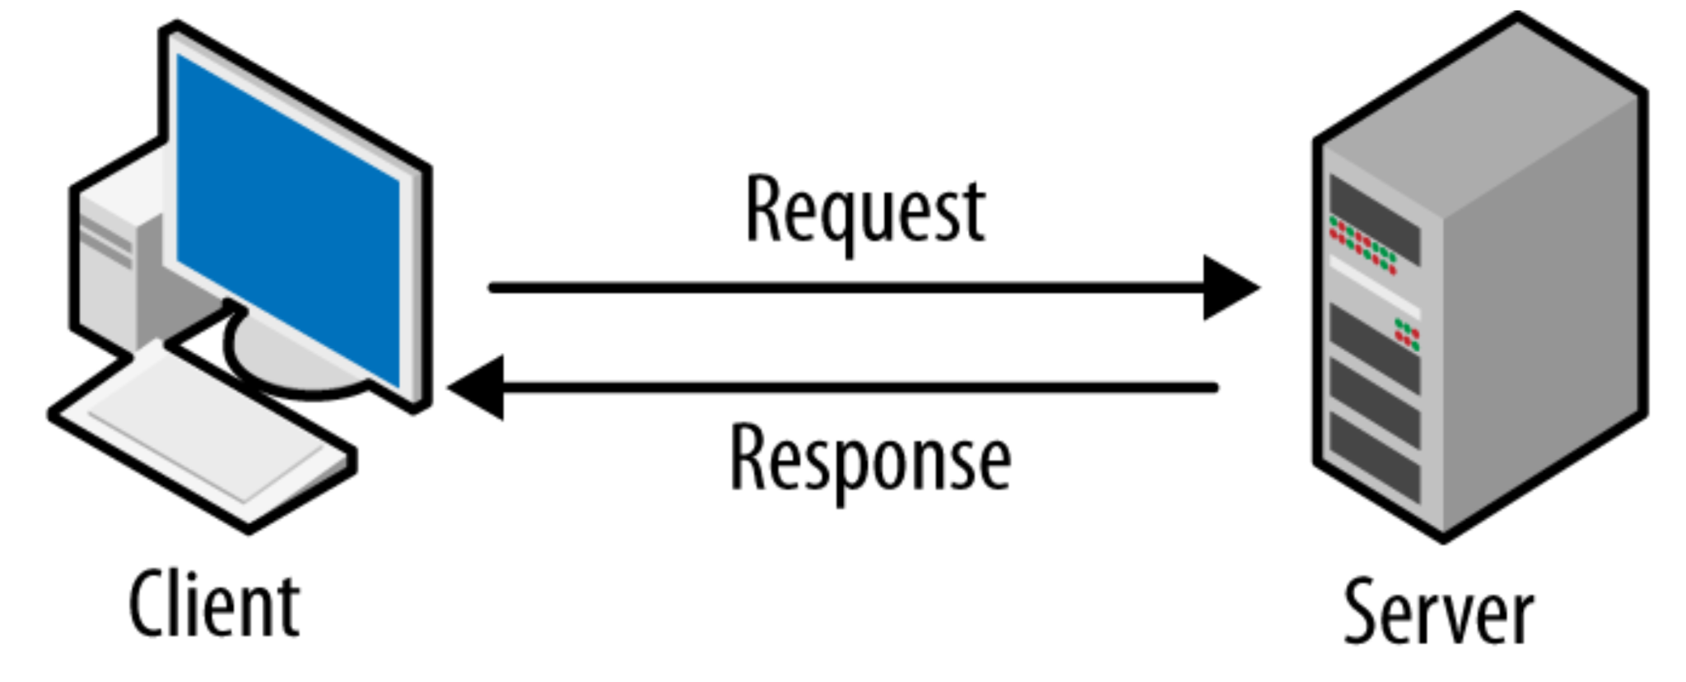
Client–server
Client makes requests to the server
Server responds to those requests
Socket.io keep a connection open to always have a request to fill

Slide 4

FE vs BE
FE is executed on the client
BE is executed on the server

Slide 5

Vue
Frontend JavaScript Framework
Views and components as a primary concept
Single page application

Slide 6

NodeJS
JavaScript runtime built
Event Loop
Single Threaded
Express

Slide 7
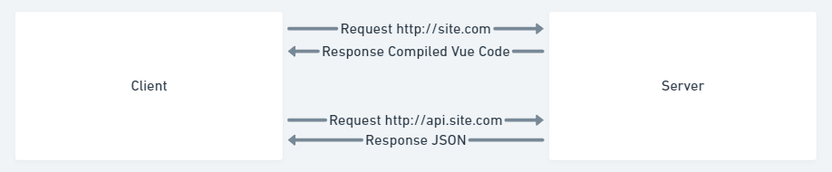
Request Response

Slide 8
JavaScript
Concepts

Slide 9
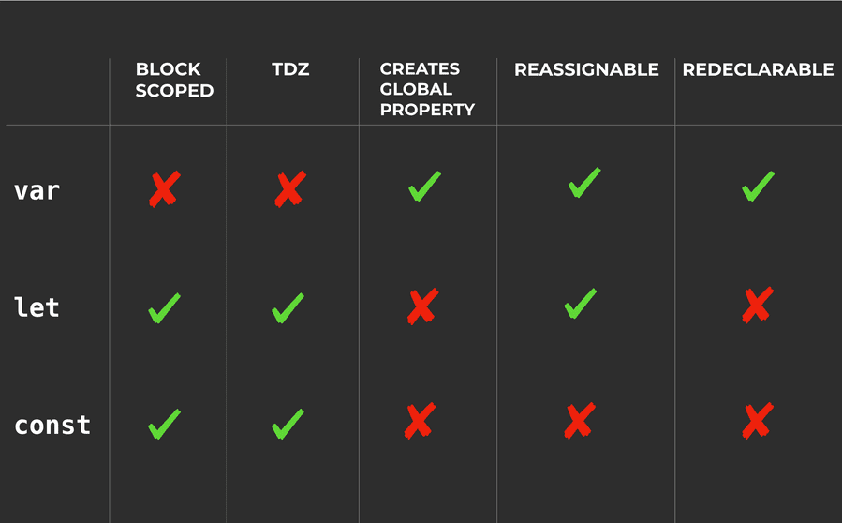
Variable Assignment
1 var v = 1;
2 let l = 2;
3 const c = 3;
4 const o = {a:4};
5 o.a = 44;
6
7 if(true){
8 var v = 11;
9 let l = 22;
10 const c = 33;
11
12 console.log(v, l, c, o.a);
13 // 11 22 33 44
14 }
15
16 console.log(v, l, c, o.a);
17 // 11 2 3 44
Use const unless you update/declare it later, then use let

Slide 10
Equality / Strict Typing
1 console.log(1 == '1'); // true
2
3 console.log(1 === '1'); // false
4
5 const obj1 = {"a": 1};
6 const obj2 = {"a": 1};
7 const refToObj1 = obj1;
8
9 console.log(obj1 == obj2); // false
10
11 console.log(obj1 === refToObj1); // true

Slide 11
Async /
Await
1 // Callback
2 getUser(function(err, user) {
3 if(err) console.error(err);
4 else
5 getProfile(user, function(err, profile) {
6 if(err) console.error(err);
7 else
8 getReport(profile, function(err, report) {
9 if(err) console.error(err);
10 else
11 send(report, function(err, success) {
12 if(err) console.error(err);
13 console.log(success);
14 });
15 });
16 });
17 });
1 // Promise
2 getUser()
3 .then(getProfile)
4 .then(getReport)
5 .then(send)
6 .then(console.log)
7 .catch(console.error);
1 // async/await
2 try {
3 const user = await getUser();
4 const profile = await getProfile(user);
5 const report = await getReport(profile);
6 const success = await send(report);
7 console.log(success);
8 } catch(err) {
9 console.error(err);
10 }

Slide 12
Promisify
& Bind
1 const util = require('util');
2 const fs = require('fs');
3 // Use require('fs').promises instead!
4
5 const readFile = util.promisify(fs.readFile);
6
7 // readFile('/etc/passwd', (err, data) => {});
8 const data = await readFile('/etc/passwd');
1 const dgram = require('dgram');
2 const util = require('util');
3
4 const client = dgram.createSocket('udp4');
5 client._send = client.send;
6
7 client.send = util.promisify(client._send).bind(client);
8
9 // client.send(message, 0, 5 41234, 'localhost', (err) => {});
10 await client.send("hello", 0, 5, 41234, 'localhost');

Slide 13
Error Handling
1 try{
2 // This will throw an error, but be caught by the try/catch block
3 somethingThatWontWork();
4 }catch(err){
5 console.error(err);
6 }
7
8 // This will throw an error and crash the application
9 somethingThatWontWork();

Slide 14
Destructuring / Spread /
Arguments
1 // Array Destructuring
2 const arr = [1, 2, 3];
3 const [one, two, three] = arr;
4 // one = 1, two = 2, three = 3
5
6 // Object Destructuring
7 const obj = { id:1, name:'test' };
8 const { id, name } = obj;
9 // id = 1, name = 'test'
1 // Array Spread
2 const oneToThree = [1, 2, 3];
3 const fourToSix = [4, 5, 6];
4 const oneToSix = [...oneToThree, ...fourToSix];
5 // oneToSix = [ 1, 2, 3, 4, 5, 6 ]
6
7 // Object Spread
8 const defaults = { a:'default', b:'default', c:'default' };
9 const opts = { b:'override', c:'override' };
10 const merged = { ...defaults, ...opts };
11 // merged = { a: 'default', b: 'override', c: 'override' }
1 // Arguments Object
2 function getRecords({ limit = 100, offset = 0, sort = 'createdAt' }) {
3 return { limit, offset, sort };
4 }
5 const values = getRecords({ offset: 10, limit: 10 });
6 // values = { limit: 10, offset: 10, sort: 'createdAt' }

Slide 15
Arrow
Functions
1 // One parameter
2 function addTen(n){
3 return n + 10;
4 }
5
6 addTen = n => n + 10;
1 // Multiple parameters
2 function addNumbers(a,b){
3 return a + b;
4 }
5
6 addNumbers = (a,b) => a + b;
1 // Block
2 function addNumbersToC(a,b){
3 c = 10;
4 return a + b;
5 }
6
7 addNumbersToC = (a,b) => {
8 c = 10;
9 return a + b;
10 }
Does not have its own bindings to this or super.
Not for call, apply and bind methods, which generally rely on a scope.
Not be used as constructors.

Slide 16
Array
Methods
1 const arr = [1,2,3,4,5,6,7,8,9,10];
2
3 // Sort
4 sorted = [...arr].sort((a,b) => { return b - a; });
5 // r>0: b before a, r<0: a before b, r=0: no change
6 // [ 10, 9, 8, 7, 6, 5, 4, 3, 2, 1]
7
8 // Filter
9 evens = arr.filter(x => x % 2 === 0);
10 // [ 2, 4, 6, 8, 10 ]
1 // Map
2 squares = arr.map(x => x * x);
3 // [1, 4, 9, 16, 25, 36, 49, 64, 81, 100]
4
5 // Reduce
6 sum = arr.reduce((acc, x) => acc + x, 0);
7 // 55
1 // Some
2 arrHas5 = arr.some(x => x === 5);
3 evensHas5 = evens.some(x => x === 5);
4 // true, false
5
6 // Every
7 hasGreaterThan5 = arr.some(x => x > 5);
8 allGreaterThan5 = arr.every(x => x > 5);
9 // true, false
* Sort will replace the current array

Slide 17
Package Specific Notes

Slide 18
Sequelize
1 let status = 'active';
2
3 // Wrong
4 await sequelize.query(`SELECT * FROM projects WHERE status = '${status}'`);
5 // SELECT * FROM projects WHERE status = 'active'
6
7 // Not Wrong
8 await sequelize.query(
9 'SELECT * FROM projects WHERE status = :status',
10 { replacements: {status} }
11 );
12 // SELECT * FROM projects WHERE status = 'active'
1 status = "active'; DROP TABLE projects; --";
2
3 // Wrong
4 await sequelize.query(`SELECT * FROM projects WHERE status = '${status}'`);
5 // SELECT * FROM projects WHERE status = 'active'; DROP TABLE projects; --'
6
7 // Not Wrong
8 await sequelize.query(
9 'SELECT * FROM projects WHERE status = :status',
10 { replacements: {status} }
11 );
12 // SELECT * FROM projects WHERE status = 'active''; DROP TABLE projects; --'
1 SELECT * FROM projects WHERE status = 'active'; DROP TABLE projects; --'
1 SELECT * FROM projects WHERE status = 'active''; DROP TABLE projects; --'
Escape your vars

Slide 19
Sequelize
1 try {
2 const result = await sequelize.transaction(async (t) => {
3 const user = await User.create({
4 firstName: 'Abraham',
5 lastName: 'Lincoln'
6 }, { transaction: t });
7
8 await user.setShooter({
9 firstName: 'John',
10 lastName: 'Boothe'
11 }, { transaction: t });
12 return user;
13 });
14 } catch (err) {
15 console.error(err);
16 }
Avoid multiple queries
Use migrations

